Slide 1
Automated Condition Analysis of Roads
Joel Stansbury, Claire Chan, and Anna Shonia
CX 4240: Introduction to Computational Data Analysis
Spring 2019

Slide 2
Introduction
What are we doing?
Detecting and Classifying different types of road damage (cracking, potholes, etc.)
Why are we doing it?
GDOT needs this information in order to determine which roads to work on. The way they obtain it is very inefficient:
Performed manually; Inconsistent; expensive; requires road closure
Why is it important?
More efficient resource allocation
Make it easier for GDOT to know which roads need to be worked on; help minimize cost of fixing these roads
Notes:
Large amount of variation in previous analyses, difficult to use in predictive algorithms
No direct measurement of road condition being collected; inconsistent

Slide 3
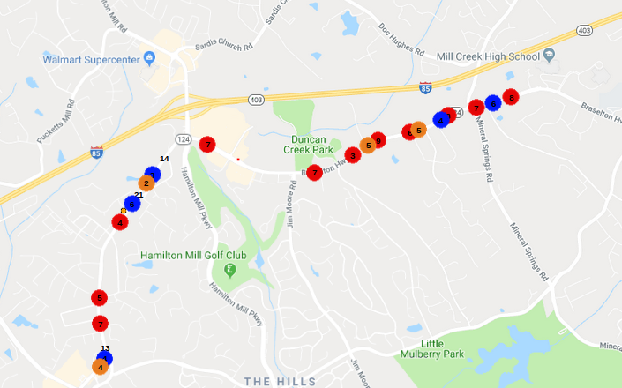
Data Collection
Made a smartphone app to record
Audio
Accelerometer
GPS
Recorded data as we drove back and forth along the path 5 times
Results of clustering algorithm over the section of road we analysed

Slide 4
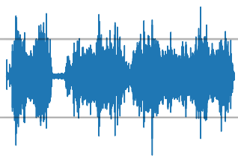
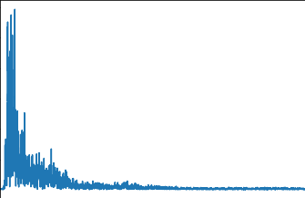
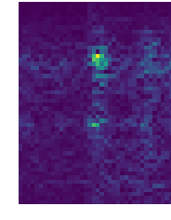
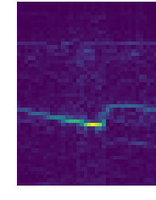
Extracting Features
Look closer at all of the points in time where the volume exceeds a user-specified threshold
At all of those points find the frequency spectrum using FFT.
We can place these frequency spectrums side by side to see how they change in time
Frequency spectrum obtained from a 1 second clip of the audio above.
Ranges from 0 to 3000Hz
Frequency
Doppler Shift
Time

Slide 5
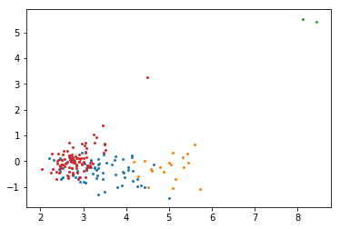
Algorithm
What is our approach to the problem?
First, SVD to perform dimensionality reduction on the feature matrix
Then, GMM algorithm for anomaly classification
What is new about this approach?
Automates analysis of road conditions
Eliminates variation between operators
Mobile app so no implementation cost
2 principle axes
Notes:
What is new?
By using unsupervised machine learning, this approach automates the analysis of road conditions and drastically reduces the time investment needed in a manual analysis
Because everything is automated, there is no room for human bias or subjectivity in the evaluation of a poor road condition

Slide 6
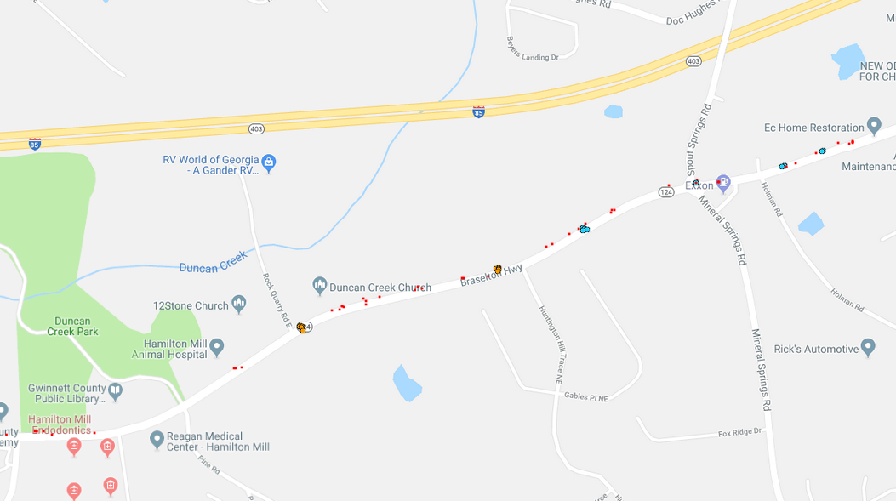
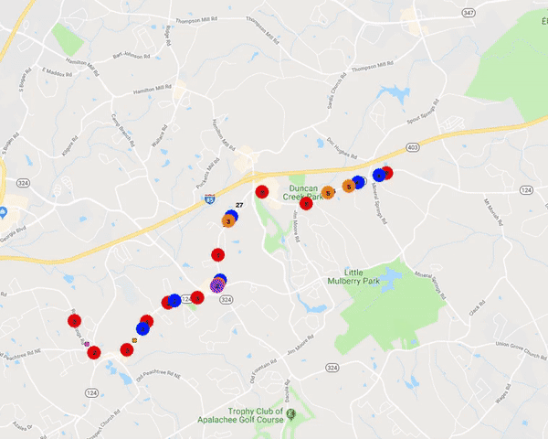
Visualization

Slide 7
Results
What methods did we use to evaluate our algorithm and what were the results?
Davies Bouldin score: 1.6004179081836094
Ratio b/w intra-cluster distance and inter-cluster distance/ avg similarity b/w each cluster
Silhouette score: 0.37762391442145105
Measure of how similar object is (avg distance) to its own cluster compared to other clusters
DBSCAN for:
Verifying that an anomaly detected is actually an anomaly
Differentiating between anomalies on opposite sides of the road
How do these methods compare to others?
Was this an efficient measure of road conditions?
Notes:
DB score: Low intra-cluster distances = high intra-cluster similarities; high inter-cluster distances = low inter-cluster similarities; the lower the better
Silhouette: The higher the better (on a scale of -1 to 1); high = well clustered; low = may be outlier
DBSCAN for:
Verifying anomaly detection → that an area of the road was detected all 5 times
Differentiating sides of the road → points could have been put in the same cluster because of their similar spatial location but turn out to be on opposite sides of the road, meaning there would be 2 different anomalies in one location; also collected data on the orientation of each anomaly, so N/S/E/W

